Slide 1
Counterfeit Pokémon Card Identifier
Building an application that can identify if a Pokémon card is fake

Slide 2
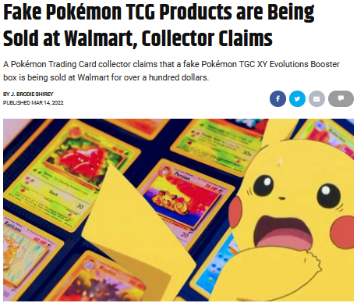
Background
In the past 3 years, there has been an explosion in popularity of Pokémon cards
Cards used to be readily available in stores. Everything is bought out and in high demand now.
With the increase in popularity, the number of counterfeit cards has also increased
https://screenrant.com/fake-pokemon-tcg-cards-sold-walmart-claims/

Slide 3
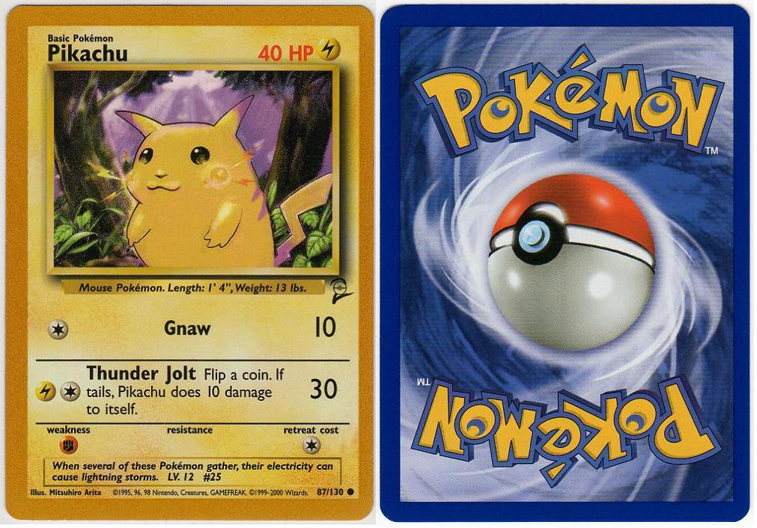
Introduction
Goal is to build an application that will analyze a photo of a Pokémon card and help identify if it is real or fake
Potential card buyers will be able to use the app to help avoid being ripped off
https://efour.proboards.com/thread/5803/base-pikachu-artwork-card-variations

Slide 4
Table of Contents
Background
Introduction
Executive Summary
Data Exploration
Methodology
Results
Recommendations
Limitations
Conclusions
References
Appendix

Slide 5
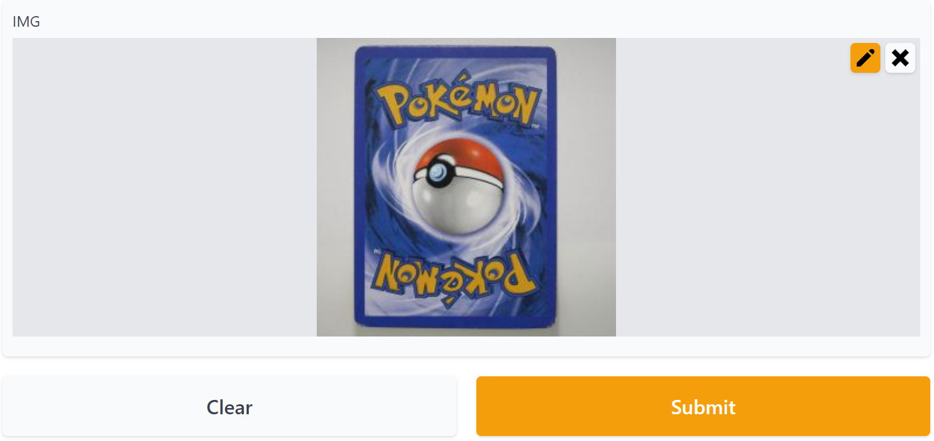
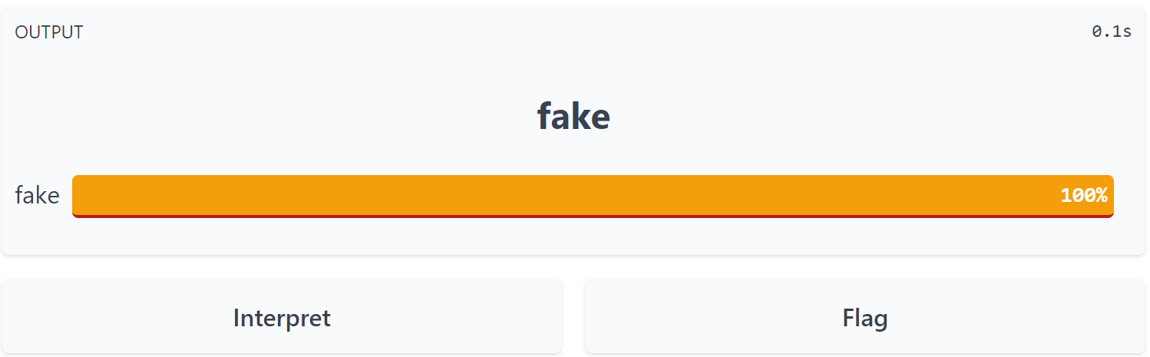
Executive Summary
Demo of the app: https://35522.gradio.app/
App has 97% accuracy when guessing for images within the original dataset, but poor accuracy for images outside of the dataset
App not yet usable for real-world use
For future model improvement, will need more labeled images from various sources for model training
Include images of the front of the cards for improved real-world use

Slide 6
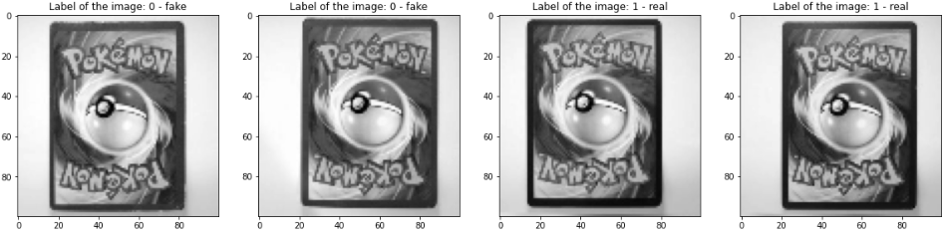
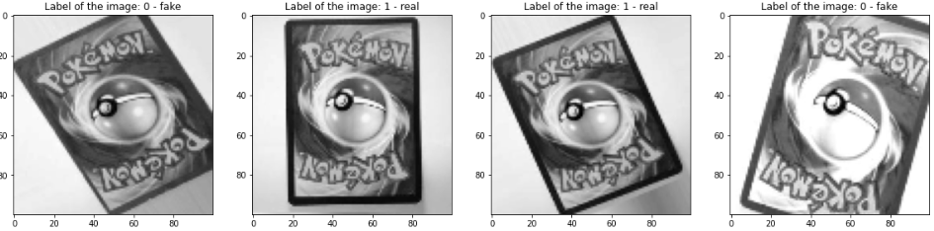
Data Exploration
Dataset source: https://www.kaggle.com/datasets/ongshujian/real-and-fake-pokemon-cards
Originally had 300 images of real cards, 151 images of fake cards
Added an additional 771 fake and 808 real augmented images, with different rotation, shear, zoom, and brightness
Resized all images to 100x100 pixels and converted to grayscale
Original images converted to 100x100 & grayscale
Modified images converted to 100x100 & grayscale

Slide 7
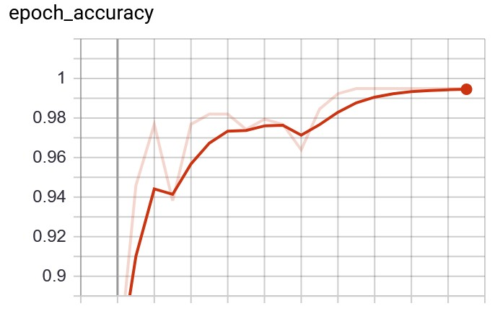
Methodology
Deep learning model using Keras API
Model used images of Pokémon cards to learn
Selected the model with the highest accuracy
Through model tuning, was able to achieve 97% accuracy when guessing if a card from the original dataset was real or fake
Accuracy performance of best selected model – test set peaks above 99%

Slide 8

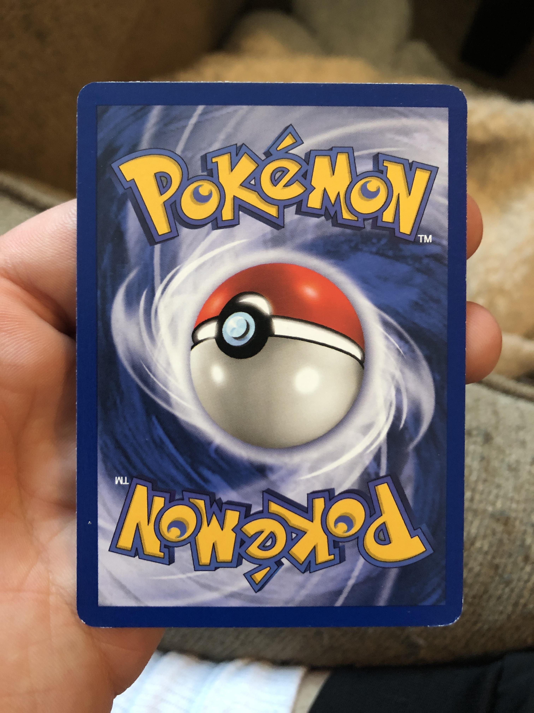
Results
97% accuracy for guessing if a card in the original dataset was real or fake
Using web app helps confirm the high accuracy
However, the web app’s accuracy noticeably worsens when using images from another source
Fake card from original dataset – app correctly identifies as fake
Real card from another source – app incorrectly identifies as fake

Slide 9
Recommendations
Compile more images of Pokémon cards from other sources to help the model learn
Develop Google or Bing script that downloads images of known real or fake cards
Include images of the front of cards
Try more model tuning to further improve model, since time was a limiting factor
Retrain model with new images included
Reevaluate app performance with new model

Slide 10
Limitations
Model was trained using CPU instead of GPU
Meaning less processing power = longer time for model to learn
Dataset very small and similar
Web app is only hosted for 3 days

Slide 11
Conclusions
The high accuracy in the validation set shows a lot of promise for real-world use
Dataset itself may be reason for worse real-world results
Very small sample size
Same source – images all have same size, lighting, quality, angle, coloring, camera, etc.
Not much is learned from images of real cards when the source is the same. It’s essentially the same image 300 times.

Slide 12
References
Shirey, J. (2022, March 14). Fake Pokémon TCG Products are Being Sold at Walmart, Collector Claims. https://screenrant.com/fake-pokemon-tcg-cards-sold-walmart-claims/
Shujian, O. (2022, February). Real and Fake Pokemon Cards. https://www.kaggle.com/datasets/ongshujian/real-and-fake-pokemon-cards

Slide 13
Appendix
Full notebook for this project can be seen here

Slide 14
Questions?

Slide 15
Thank you!

